Slide 1
Welcome all of you

Slide 2
Presentation
Some Requests
1. Please switch off the mobile or switch the mobile to flight mode.
2. This meeting will last for about 45 minutes, so please take time to
be a part of the meeting
3. Please do not ask any questions in the meeting, sit at the end and clear all your questions.

Slide 3
Money
Freedom
Luxurious
Lifestyle
Happy Family
&
Healthy Family
Successful
Career

Slide 4
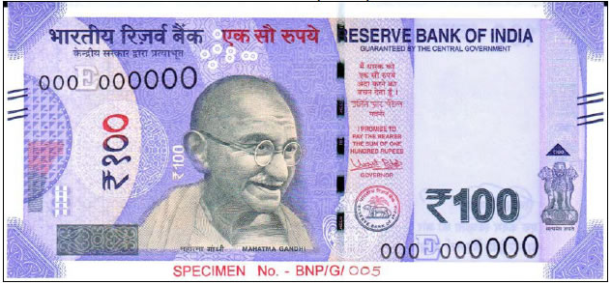
=
1 Teacher = 1 hour = 100/- Profit
=
800 rs.
10 Teacher = 1 hour x 100/- = 1000/- Profit
=
Network System
1600 rs.
?
=
3000 rs.

Slide 5
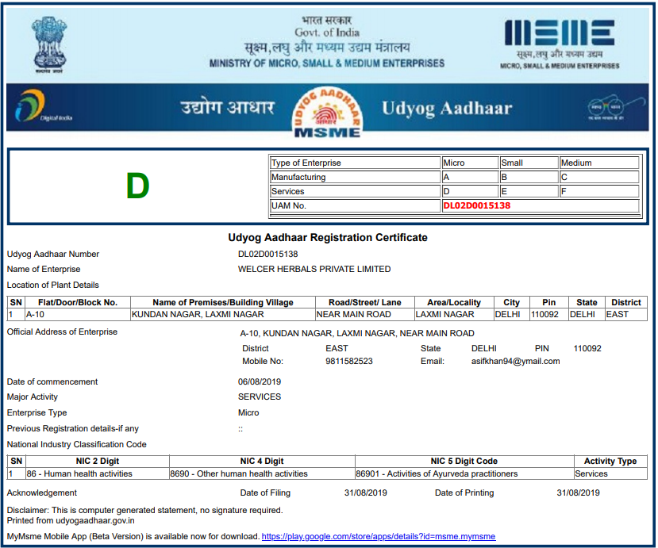
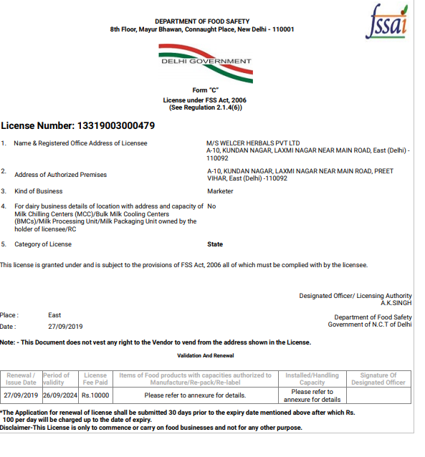
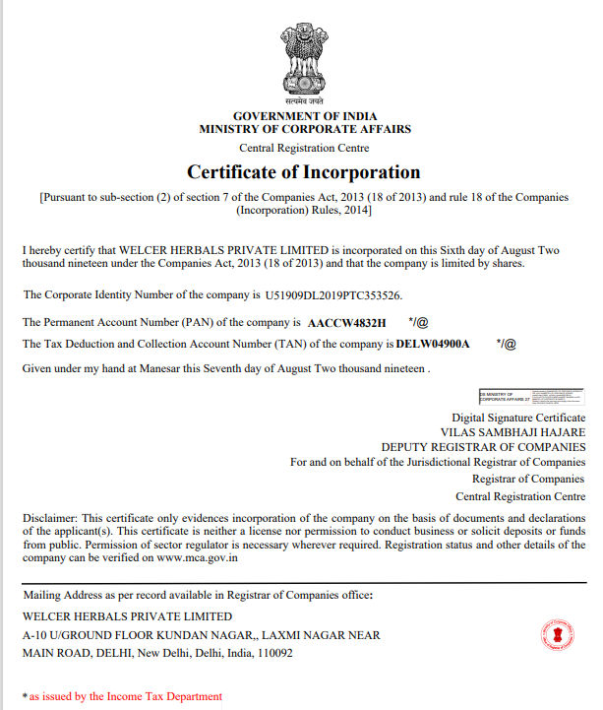
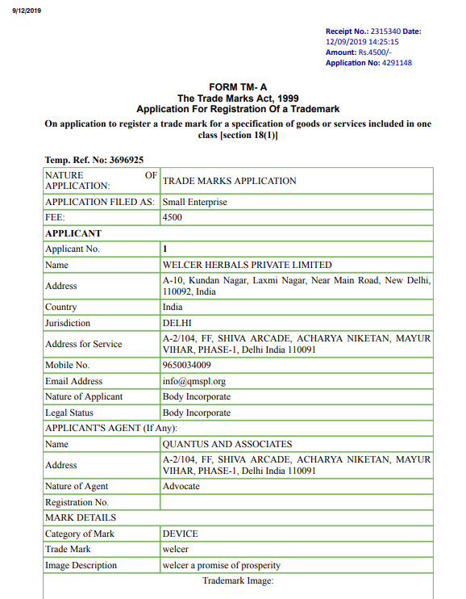
DELHI
August 2019
Herbals Products
आयुर्वेद प्रोडक्स
80+ Products 100% Chemical Free
Welcer Herbals Pvt. Ltd.
Food Supplement
Health Care Product
Beauty Product
FMCG Product
3 lakh Satisfied Families
3 लाख परिवार जो हमारे संतुष्ट ग्राहक भी है और हमारे बिज़नेस पार्टनर भी

Slide 6
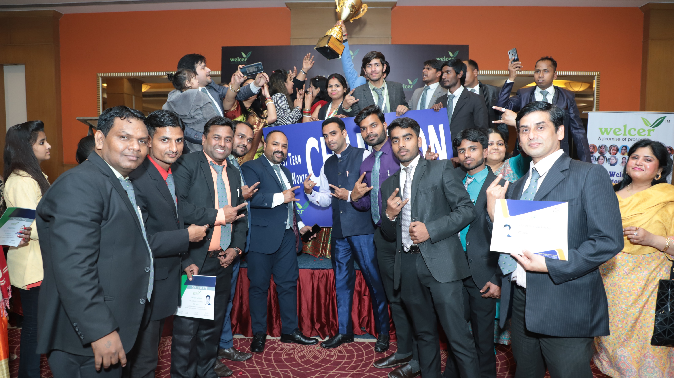
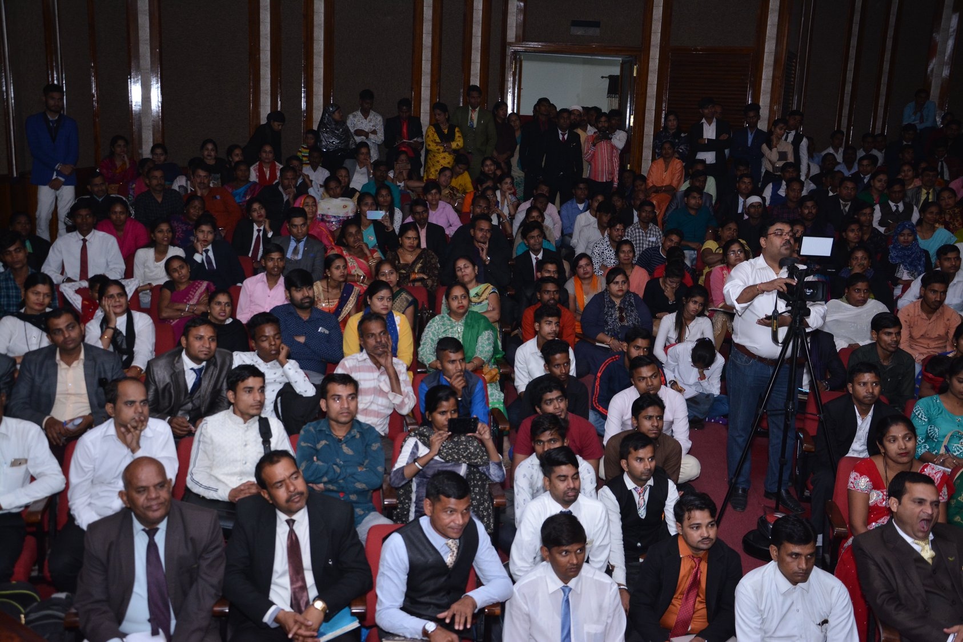
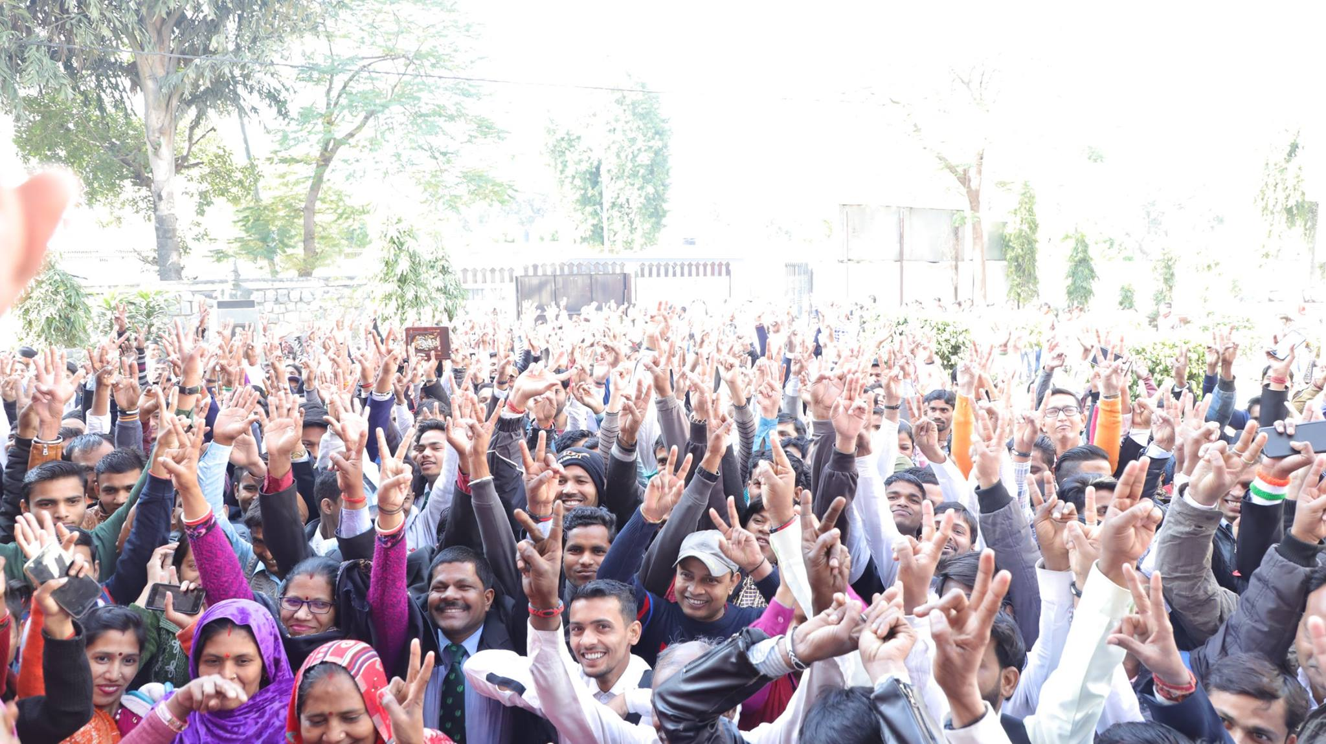
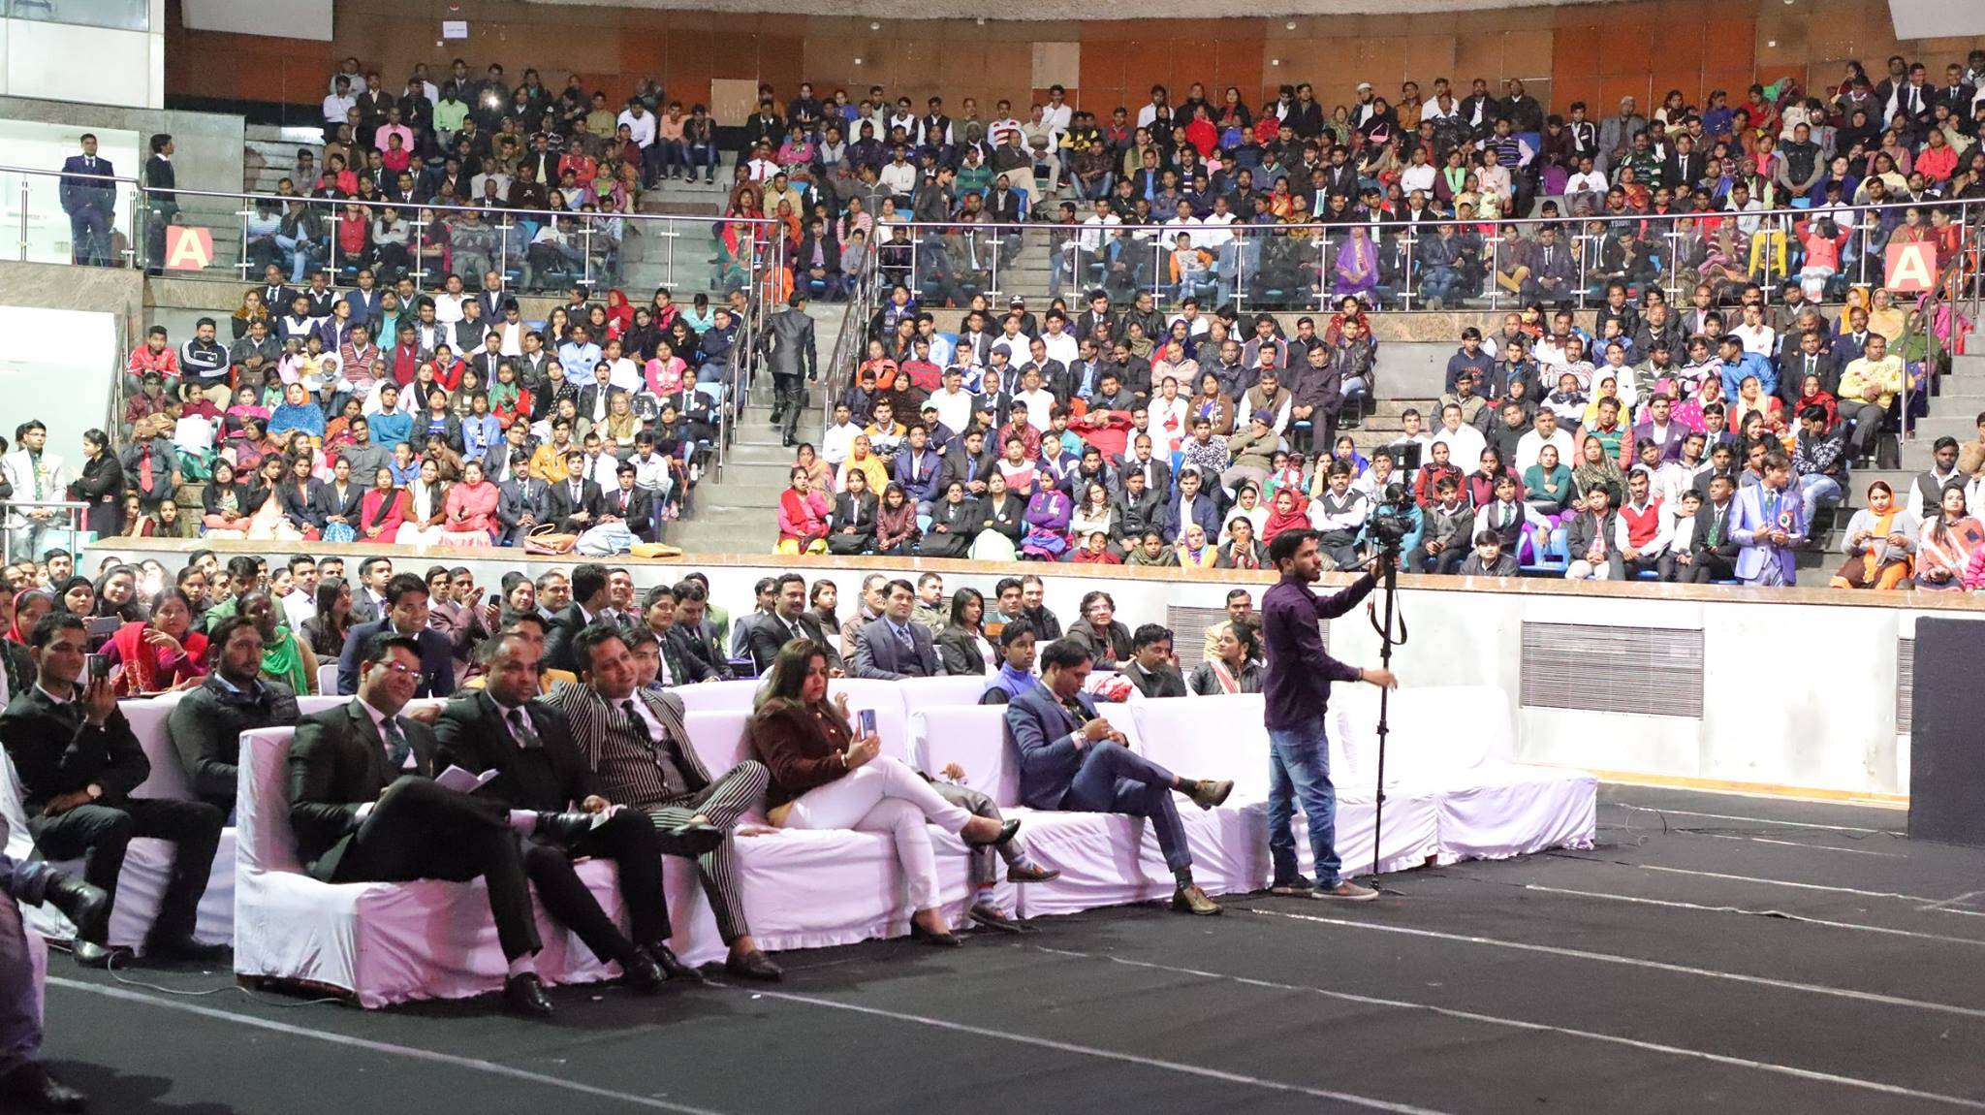
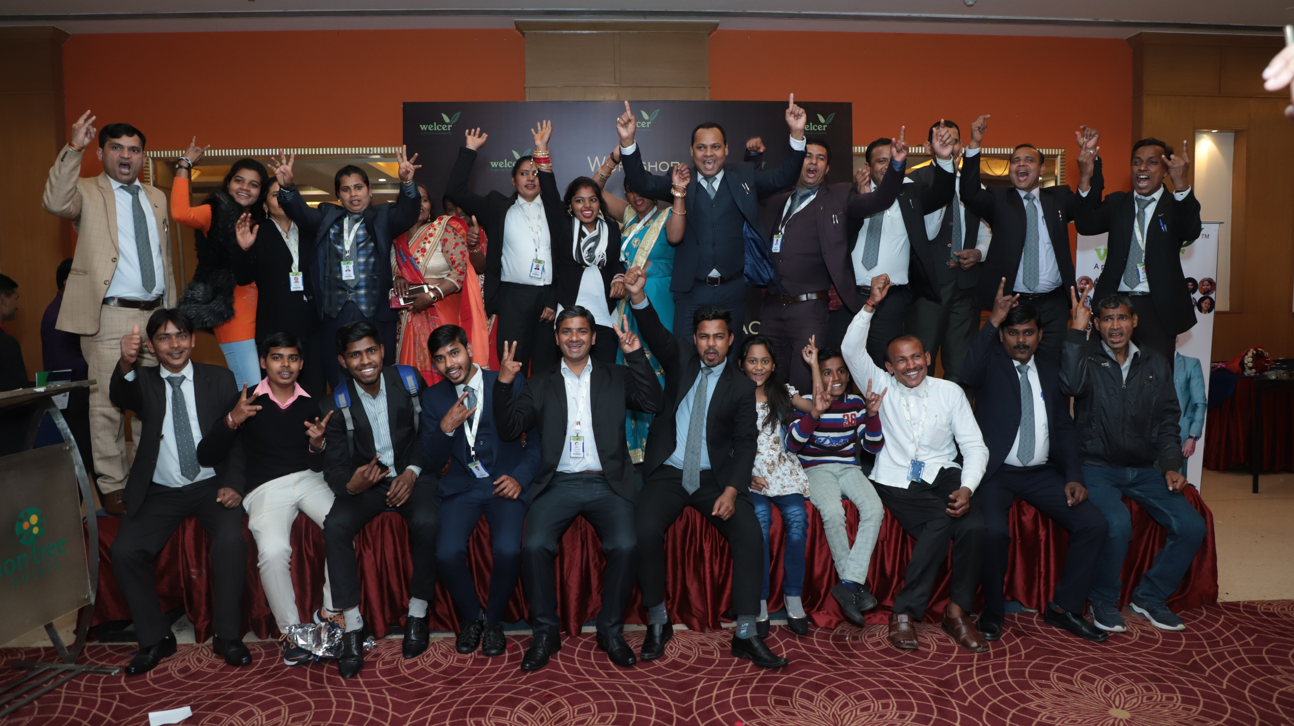
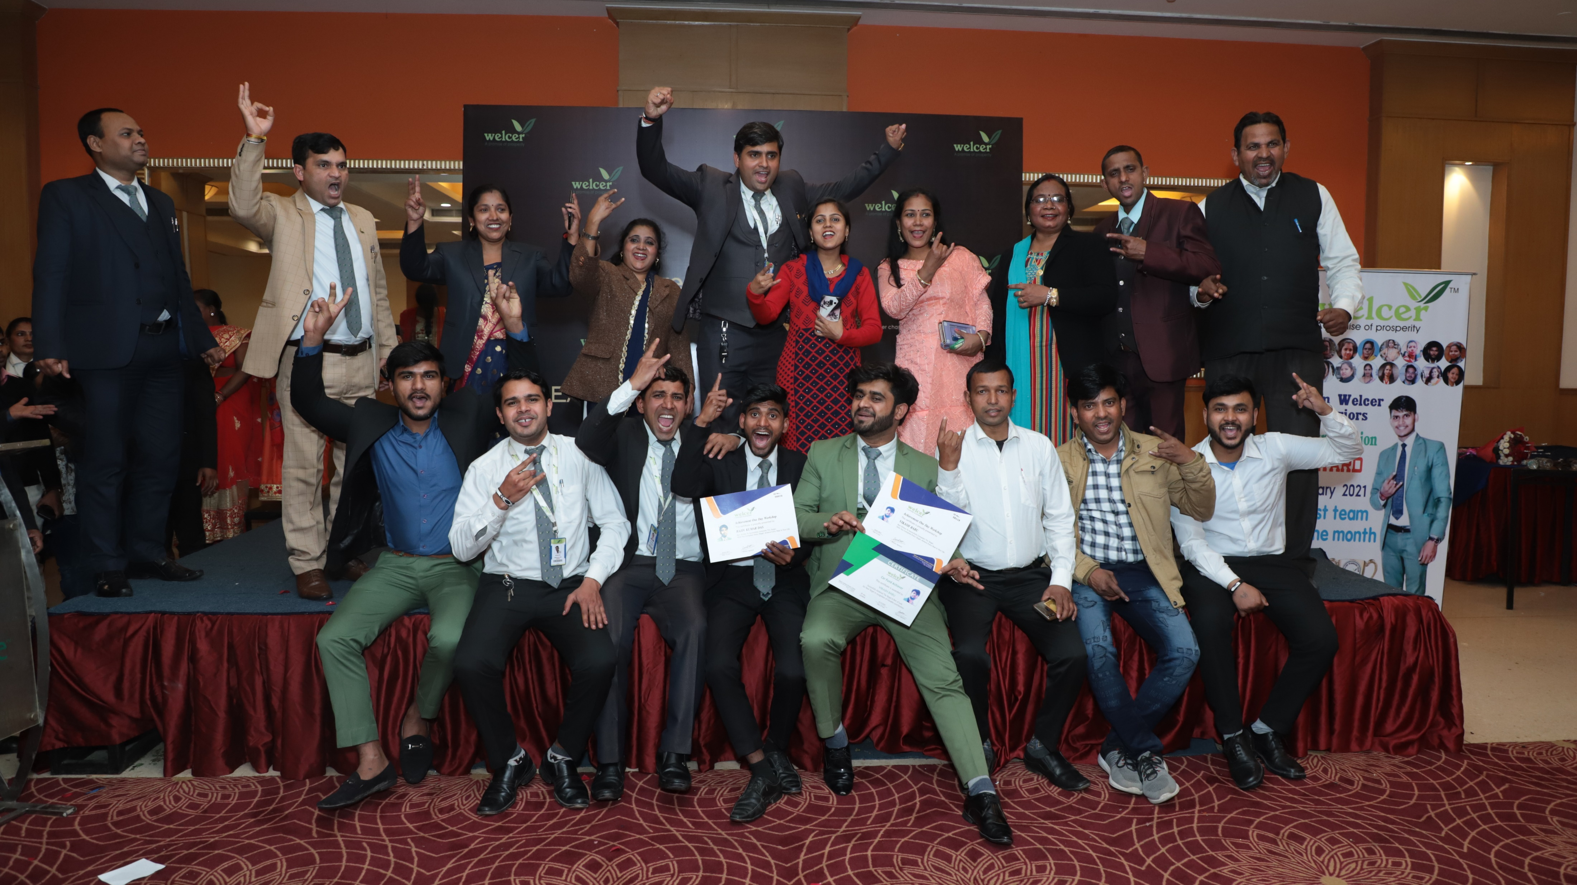
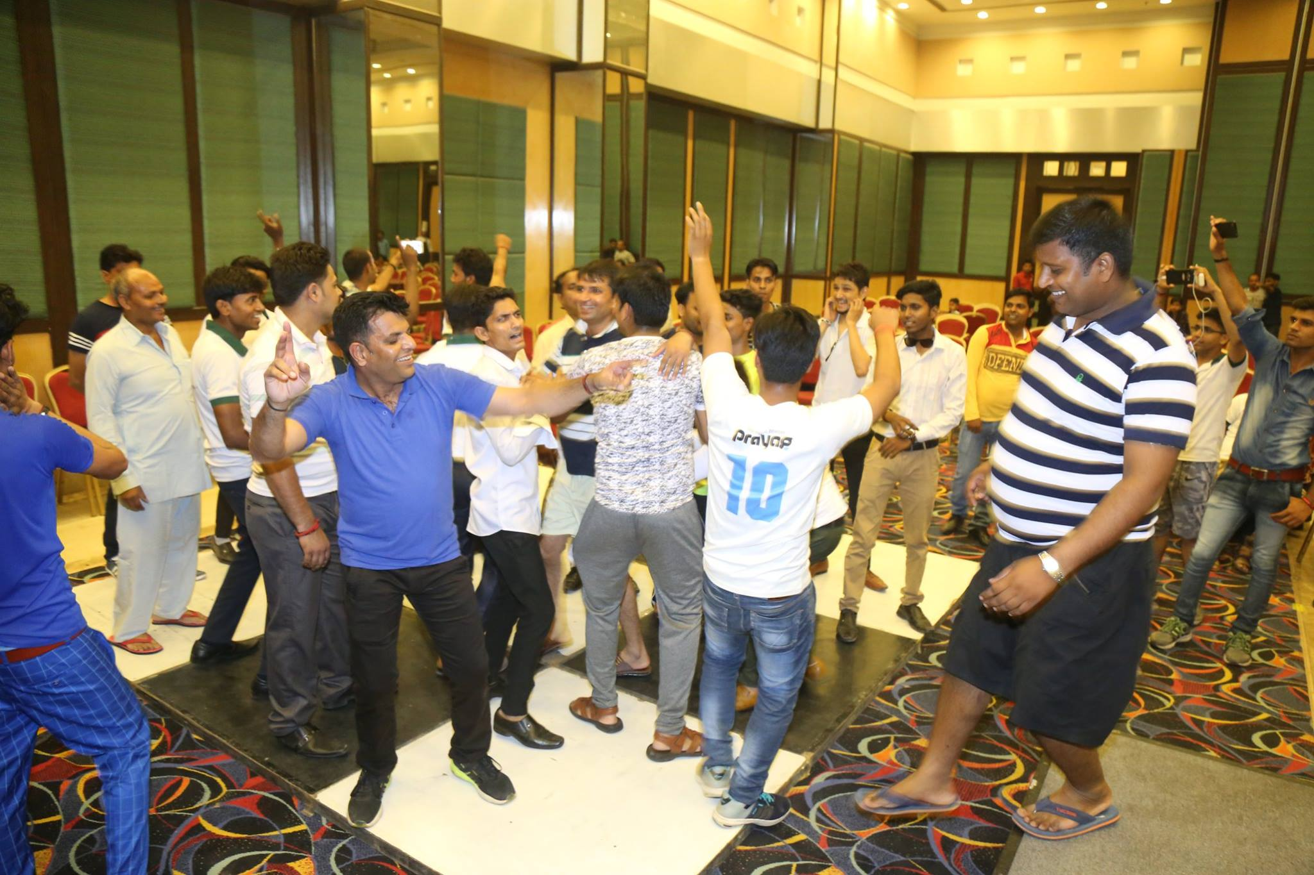
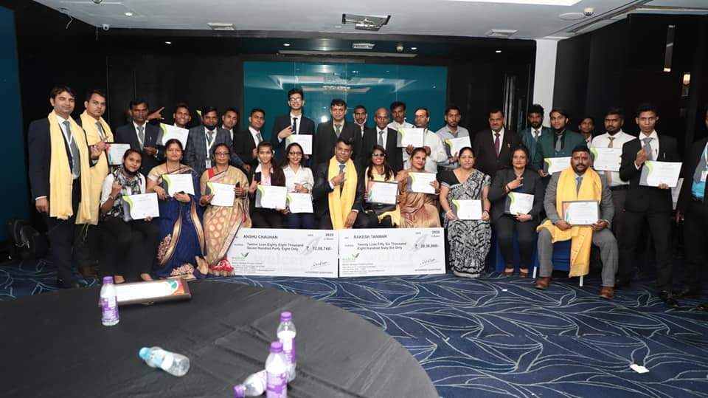

Slide 7
Products.

Slide 9
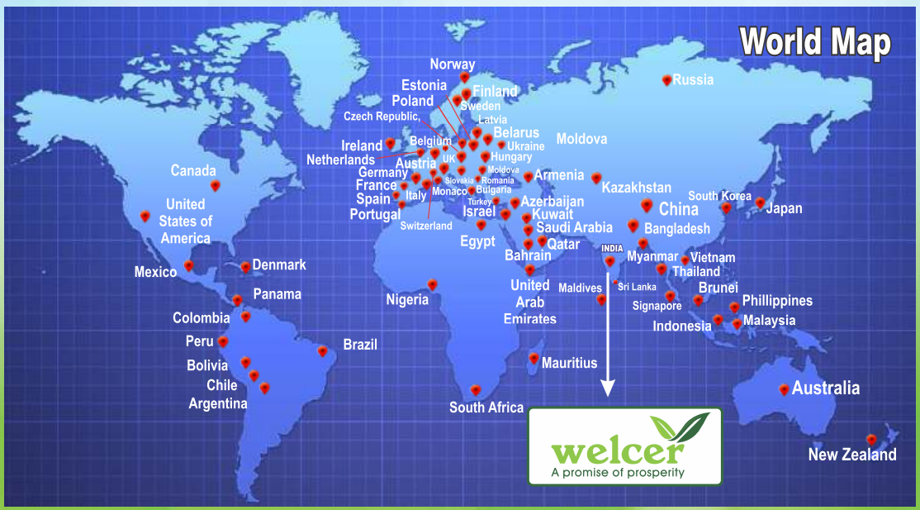
दुनिया के 70 देशो में बेहतरीन रिसल्ट देने के बाद अब नो प्रॉब्लम ब्रेसलेट भारत में भी उपलब्ध
ये एक अध्भुत हेल्थ डिवाइस है ,
आज तक आपने खाने की दवाई सुनी होगी या लगाने की सुनी होगी
पर ये पहनने वाली दवाई है
यह एक दवाई है ये बात सिर्फ हम नहीं कर रहे बल्कि अमेरिकी संसथान U.S.F.D.A कह रही है
यह 70 देशो में बिकने वाला हेल्थ डिवाइस है जो भारत में वेलसर के पास उपलब्ध है

Slide 11
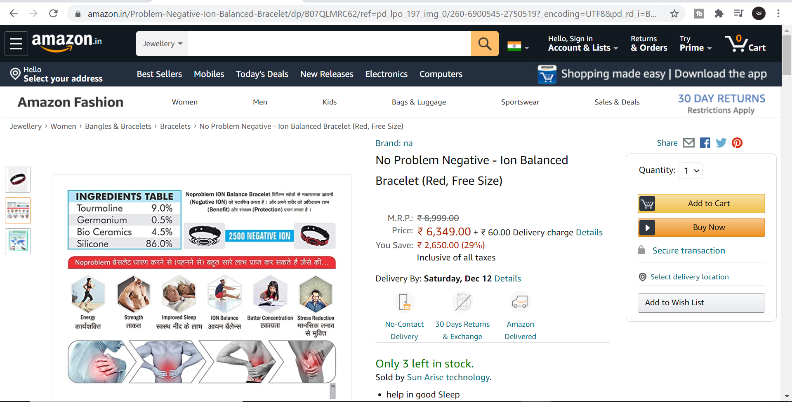

Slide 12
6400/-
X 2 Bracelet
= 12,800/-
+ 1200/- (Welcer Product)
= 14,000/-
2 Bracelet + 1200/- (Welcer Health Supplement )
= 6600/-

Slide 13
Use the Product & Promote the Product
पहले आप स्वम प्रोडक्ट इस्तेमाल करे ,उसके बाद उसका मिलकर प्रचार करे
A
B
C

Slide 14
8
15% - 20%
27%
10%
10%
5%
4%
3%
8
3000 MV Matching
1 Performance Bonus Point
1 Point Value
Approximately 170/- rs
50,000 MV Matching
1 Leadership Bonus Point
1 Point Value
Approximately 1600/- rs
50,000 MV Matching*
1 Car Fund Point
1 Point Value
Approximately 700/- rs
6000 MV Matching
1 Manager Bonus Point
1 Point Value
Approximately 140/- rs
25,000 MV Matching*
1 Tour Point
1 Point Value
Approximately 300/- rs
1,00,000 MV Matching*
1 House fund Point
1 Point Value
Approximately 1500/- rs
Self Purchasing
1%

Slide 15
Left
You
Right
6600
6600
Approx 500/-
Approx 500/-
Approx 500/-

Slide 16
Success Chart
1 MONTH
TOTAL ONE YEAR TEAM 8190
2
2 MONTH
2 X 2
= 4
3 MONTH
4 X 2
= 8
4 MONTH
8 X 2
= 16
5 MONTH
16 X 2
= 32
6 MONTH
32 X 2
= 64
7 MONTH
64 X 2
4000
4000
= 128
8 MONTH
128 X 2
= 256
9 MONTH
256 X 2
= 512
4000 x 500
10 MONTH
512 X 2
= 1024
11 MONTH
1024 X 2
= 2048
RS.20,00,000/-
12 MONTH
2048 X 2
= 4096

Slide 18
“YOU HAVE’’
DREAMS
CONFIDENCE
JUST
DO
IT
POSITIVE ATTITUDE

Slide 19
A-10, Kundan Nagar, Laxmi Nagar Main Road, Delhi-110092
welcer Herbals
welcer Motivation
welcer
Welcer motivation
www.welcer.com

